Slide 1

LEAF DISEASE DETECTION USING IMAGE PROCESSING
TEAM MEMBERS
KALAISELVI M R
PREETHAM S
KEERTHANA R
MATHIMALAR M
JISSHNU H J
HARISH RAGAVENDRA P

Slide 2
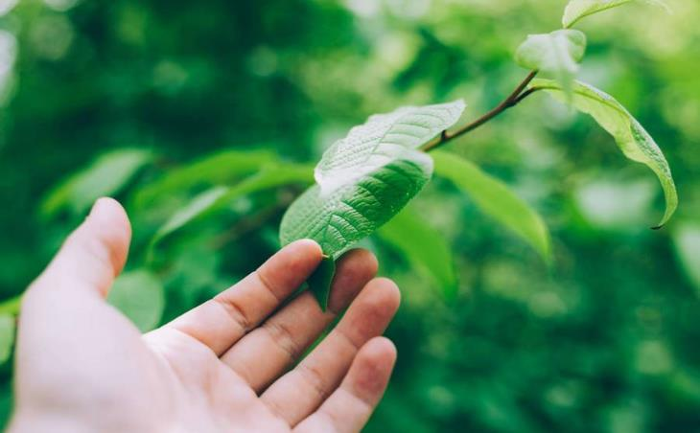
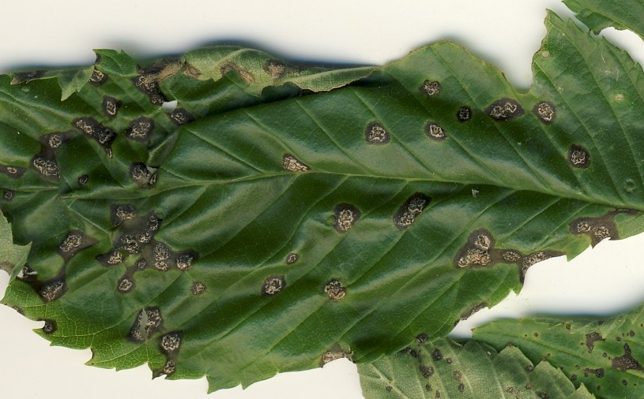
Agenda
ABSTRACT
STEPS INVOLVED
PREVIOUS MODELS OF LEAF DISEASE DETECTION
PRESENT DAY ANALYSIS OF LEAF DISEASE DETECTION
FUTURE ASPECTS

Slide 3

ABSTRACT
Plant diseases are the major problems in the agricultural field. Identifying plant disease wrongly leads to huge loss of yield, time, money and quality of product. The severity of the disease in the leaves can be detected using image processing which is utilized for automatic categorization of leaf diseases. The main objective is to design a CNN model- Convolutional neural network that can detect crop disease and pest to be used accurately

Slide 4

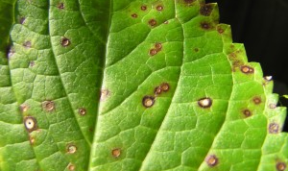
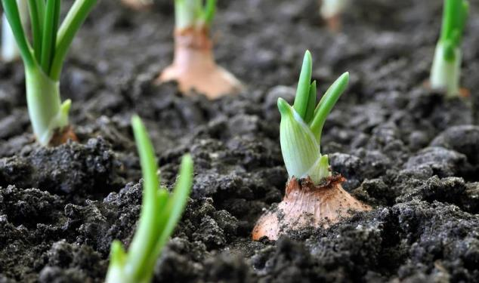
PROCESS INVOLVED
1.The process starts with data collection where the images of the leaves are the input which are used as training data set.
2.After that data cleaning and preprocessing take place where data augmentation also occur
3.After this model building is done using CNN-Convolutional Neural Network where the images are classified
4.Then the trained model is exported and the disease is identified

Slide 5
FLOW Chart
TRAINSET
INPUT LEAF IMAGE
PREPROCESSING
CNN CLASSIFICATION
TESTSET
OUTPUT
PREDICTION

Slide 6
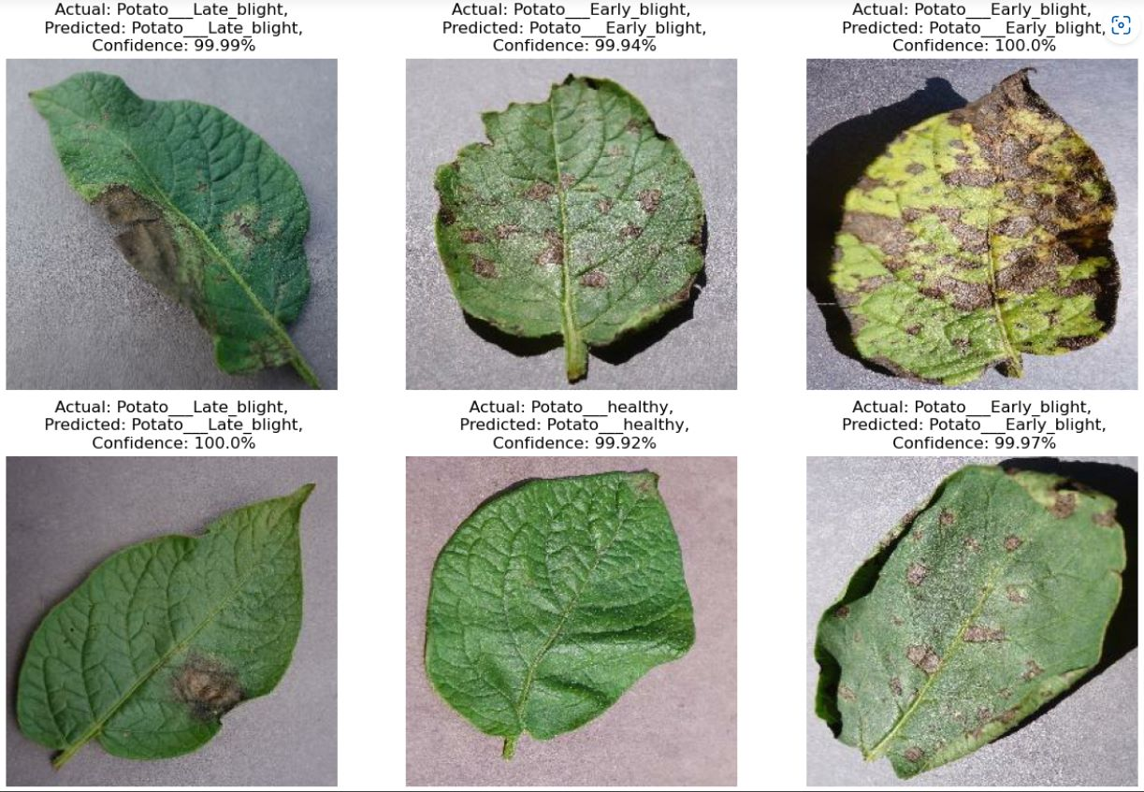
table
 | Category 1 | Category 2 | Category 3 | Category 4
Item 1 | 4.5 | 2.3 | 1.7 | 5.0
Item 2 | 3.2 | 5.1 | 4.4 | 3.0
Item 3 | 2.1 | 1.7 | 2.5 | 2.8
Item 4 | 4.5 | 2.2 | 1.7 | 7.0

Slide 7
The infection spots are initially seen as spots and patterns on leaves. Researchers have proposed several techniques to accurately detect and classify plant infections.
Previously traditional image processing techniques were used that incorporate hand-crafted—that is, manual—feature extraction and segmentation.
Many models using traditional methods have been proposed for disease recognition in plants. Although the image processing methods achieved promising results, the process involved in disease recognition is still tedious and time-consuming. Furthermore, the models rely on hand-crafted featuring techniques, classification, and spot segmentation.

Slide 8
PRESENT DAY ANALYSIS OF LEAF DISEASE DETECTION
PROBLEM FACED AND IMPOVEMENTS REQUIRED
Since the evolution of artificial intelligence many researches in machine learning and deep learning is done
convolution neural networks (CNNs) have gained wide attention for their recognition and classification abilities, which work by extracting low-level complex features from images
Hence, CNNs are preferred for the replacement of traditional methods in automated plant disease recognition as they achieve better outcomes.
Little diversity in dataset used
The best outcome is likely to be achieved by training the deep-learning model using a large dataset.
The models trained with the existing datasets lack diversity in the data and backgrounds compared to realistic photographed materials obtained from real agricultural fields.

Slide 9

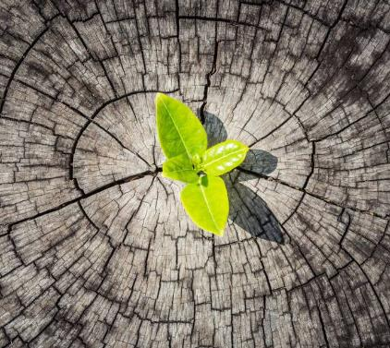
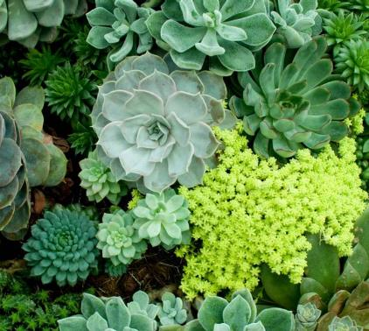
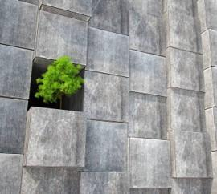
FUTURE DETECTION
Considerable progress in developing automated diagnostics is happening and the introduction of advanced image segmentation and tiling techniques promises to be a major leap forward.
As with all AI/ML applications, numbers of images included in the models really improve the quality of the final predictions. “The success of any machine learning model is rooted in the quality and quantity of the data it is trained on,

Slide 10
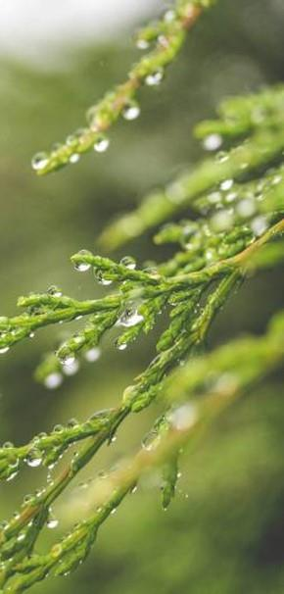

Thank you

